Slide 1



INSTITUTE - UIE
Bachelor of Engineering (Computer Science & Engineering) Subject Name : CALCULUS & VECTOR SPACES
Subject Code : 20SMT-175
BE :CSE(All IT branches)
DISCOVER . LEARN . EMPOWER
Multiple Integrals

Slide 2
Course prerequisites
Basic Knowledge of Differentiation.
Basic Knowledge of Integration.
Basic Knowledge of Limits.
Basic Knowledge of binary operations.
Course Outcomes
CO Number | Title | Level
CO1 | The concept of partial derivatives and its application in real life situations The concept of Multiple Integrals and its applications. | Remember & Understand
CO2 | The concept of Group theory and its application of analysis to Engineering problems. | Remember & Understand
CO3 | The concept of vector spaces in a comprehensive manner. | Remember & Understand

Slide 3
Topic Pre-Requisites
Basic idea of Differentiation.
Basic concepts of functions with one independent variables.
Basic knowledge of formulae of simple Integration

Slide 4
Topic outcomes
Students will able to evaluate double and triple integrals.
Students will able to find area and volume using double integrals.
Students will able to find volume using triple integrals.

Slide 5
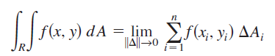
Double integrals
If f is defined on a closed, bounded region R in the xy-plane, then the double integrals of f over R is
provided the limit exists. If the limit exists, then f is integrable over R.
The expression:
is called a double integral and indicates that f (x, y) is first integrated with respect to x and the result is then integrated with respect to y.

Slide 6
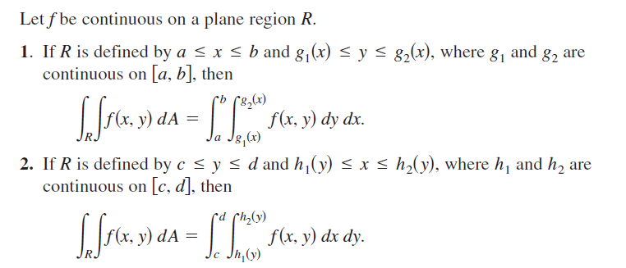
Evaluation of Double Integrals
Fubini’s Theorem :

Slide 7
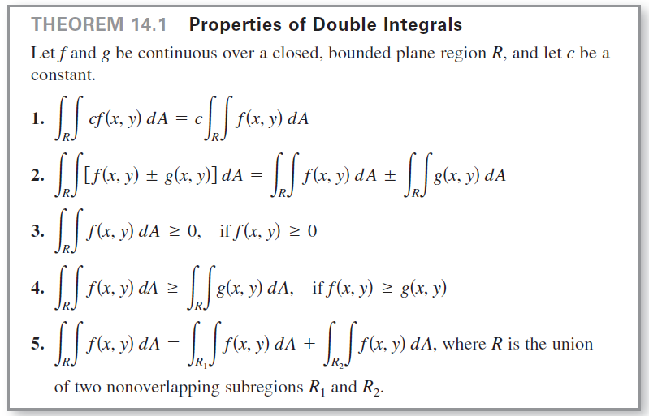
Properties of Double Integrals

Slide 8
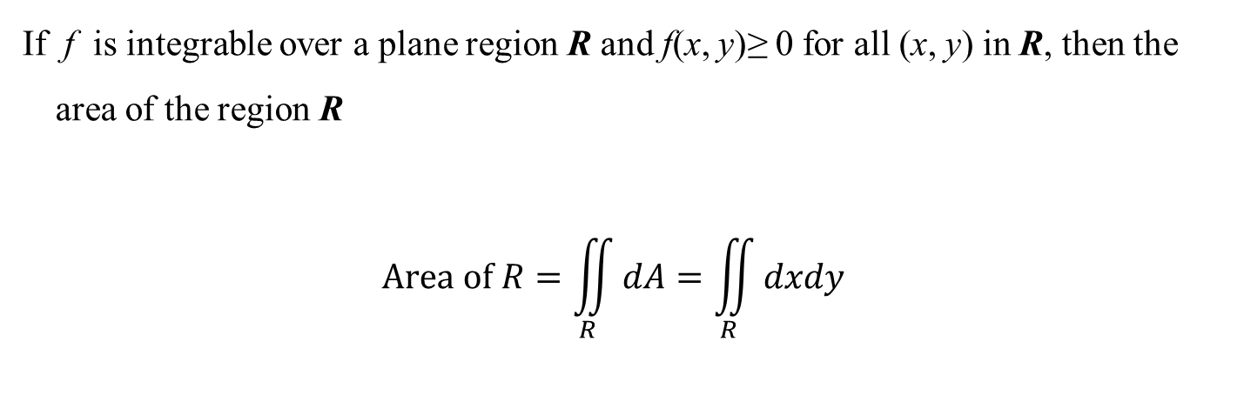
Double Integrals and Area of a Region
If f is integrable over a plane region R and f(x, y)≥ 0 for all (x, y) in R, then the area of the region R
$$Area of R=\iint_{R}{dA=\iint_{R}{dxdy}}$$

Slide 9
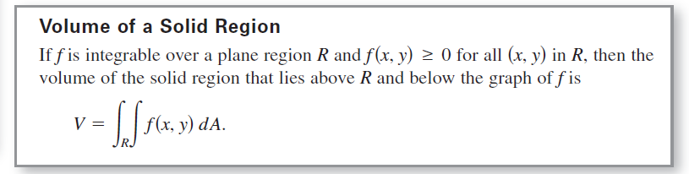
Double Integrals and Volume of a Solid Region
A double integral can be used to find the volume of a solid region that lies between the xy-plane and the surface given by z = f(x, y).
Volume of a Solid Region
If f is integrable over a plane region R and f(x, y)≥ 0 for all (x, y) in R, then the volume of the solid region that lies above R and below the graph of f is

Slide 10
Triple integrals
The expression:
is called a triple integral and is evaluated by starting with the innermost integral and working outwards.
If the six limits on the integral are all constant the order in which the integrations are performed does not matter.
If the limits on the integrals involve some of the variables then the order in which the integrations are performed is crucial.

Slide 11
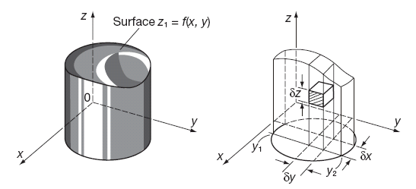
Triple Integrals and Volume of a Solid Region
Determination of volumes by multiple integrals
The element of volume is:
Giving the volume V as:
That is:

Slide 12
Applications
To find Area of a Region
To find Volume under a Surface.
Multiple Integrals are used effectively in Engineering.

Slide 13

Text Books & Reference Books
Text Books:
1. E. Kreyszig , Advanced Engineering Mathematics, John Wiley,10th Ed.2011.,New Delhi.
2. H.K. Dass., Higher Engineering Mathematics, S Chand Publishers, 3rd revised edition, 2014.
3. B.S.Grewal, Higher Engineering Mathematics, Khanna Publishers, 42th ed.2013, New Delhi.
Reference Material:
R.K. Jain, and S.R.K. lyengar, Advanced Engineering Mathematics, 3rd Edition, Narosa Publishing House,
2004, New Delhi.
2. B.V. Ramana Advanced Engineering Mathematics, McGraw Hill, July 2006, New Delhi.
3. B. Thomas and , R.L., Finney ,Calculus and Analytic Geometry, Pearson Education, 11th Edition.
4. N.P. Bali and Manish Goyal, A text book of Engineering Mathematics, Laxmi Publications, Reprint, 2008.

Slide 14
THANK YOU

